Slide 1


Sentiment Analysis of IMDB Movie Reviews
This project explores sentiment analysis using a dataset of IMDB movie reviews. By analyzing the reviews, we can understand the emotional tone surrounding films and gain valuable insights into audience preferences.

Slide 2
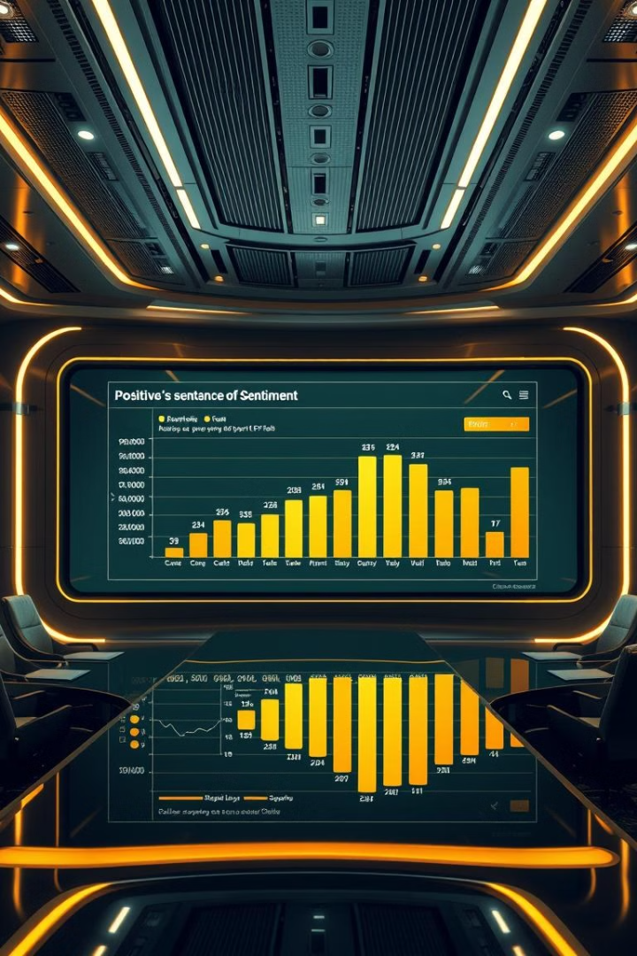
Introduction to Sentiment Analysis
Sentiment analysis, also known as opinion mining, is a natural language processing (NLP) technique that uses computational methods to identify and extract subjective information, like opinions, emotions, and attitudes from text data.
1
Subjectivity
2
Polarity
Sentiment analysis focuses on identifying subjective expressions rather than objective facts.
It analyzes the sentiment expressed in text as positive or negative.
3
Applications
Sentiment analysis has wide-ranging applications, including customer feedback analysis, market research, and brand monitoring.

Slide 3
Importance of Sentiment Analysis in the Movie Industry
Sentiment analysis provides valuable insights for the movie industry, helping studios make informed decisions regarding production, marketing, and distribution.
Market Research
Audience Engagement
Content Improvement
Analyze audience sentiment towards upcoming movies to predict box office success.
Understand customer reactions to trailers, posters, and promotional campaigns to refine marketing strategies.
Identify areas for improvement in movie scripts and storytelling based on audience feedback.

Slide 4

Dataset: IMDB Movie Reviews
The dataset used in this project is a collection of IMDB movie reviews, spanning a range of genres and containing diverse opinions and sentiments expressed by viewers.
Attribute
Description
Review Text
The actual text of the movie review.
Sentiment
Label indicating whether the review is positive or negative.

Slide 5

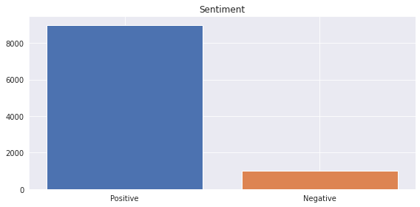


Distribution Of Data
We can see that the data is unbalanced..
Precision
The proportion of positive predictions that were actually positive.
Recall
The proportion of positive reviews that were correctly identified as positive.
F1-Score

Slide 6

Sentiment Classification Most Famous Models
Various machine learning models were used to classify the sentiment of movie reviews, each leveraging different approaches to analyze the text data.
Naive Bayes
Support Vector Machines (SVM)
A probabilistic model based on Bayes' theorem that calculates the probability of a review being positive or negative based on the words it contains.
A supervised learning algorithm that finds an optimal hyperplane to separate data points into different classes based on their features.
Recurrent Neural Networks (RNNs)
A type of neural network that excels in processing sequential data, like text, by remembering information from previous parts of the sequence.

Slide 7

Project Table of Content
All the steps for that project
1
Importing necessary libraries
2
Preparing the data
3
Text Representation (Bag of words)
3
1
4
Model Selection
2
5
Model Evaluation

Slide 8


Evaluating Model Performance
After training the models, their performance was evaluated using various metrics to determine their effectiveness in predicting sentiment.
Accuracy
The percentage of correctly classified reviews.
Precision
The proportion of positive predictions that were actually positive.
Recall
The proportion of positive reviews that were correctly identified as positive.
F1-Score
A harmonic mean of precision and recall, providing a balanced measure of model performance.

Slide 9
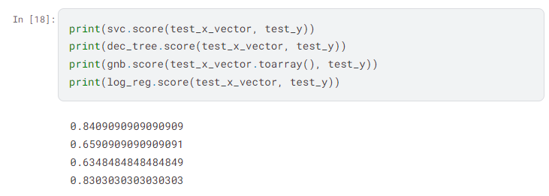
Evaluating Model Performance
After training the models, their performance was evaluated using various metrics to determine their effectiveness in predicting sentiment.
Accuracy
The percentage of correctly classified reviews.

Slide 10
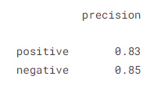
Evaluating Model Performance
After training the models, their performance was evaluated using various metrics to determine their effectiveness in predicting sentiment.
Precision
The proportion of positive predictions that were actually positive.

Slide 11
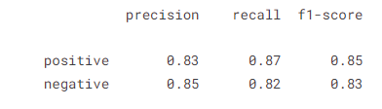

Evaluating Model Performance
After training the models, their performance was evaluated using various metrics to determine their effectiveness in predicting sentiment.
Recall
The proportion of positive reviews that were correctly identified as positive.
F1-Score
A harmonic mean of precision and recall, providing a balanced measure of model performance.

Slide 12

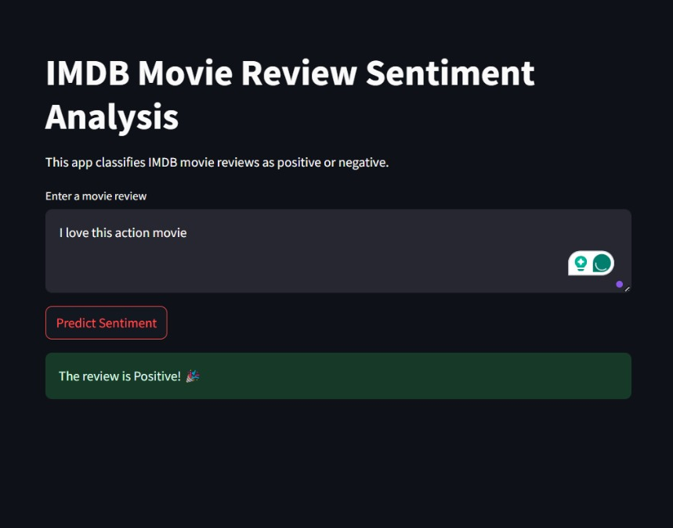
Streamlit Web App Deployment

Slide 13
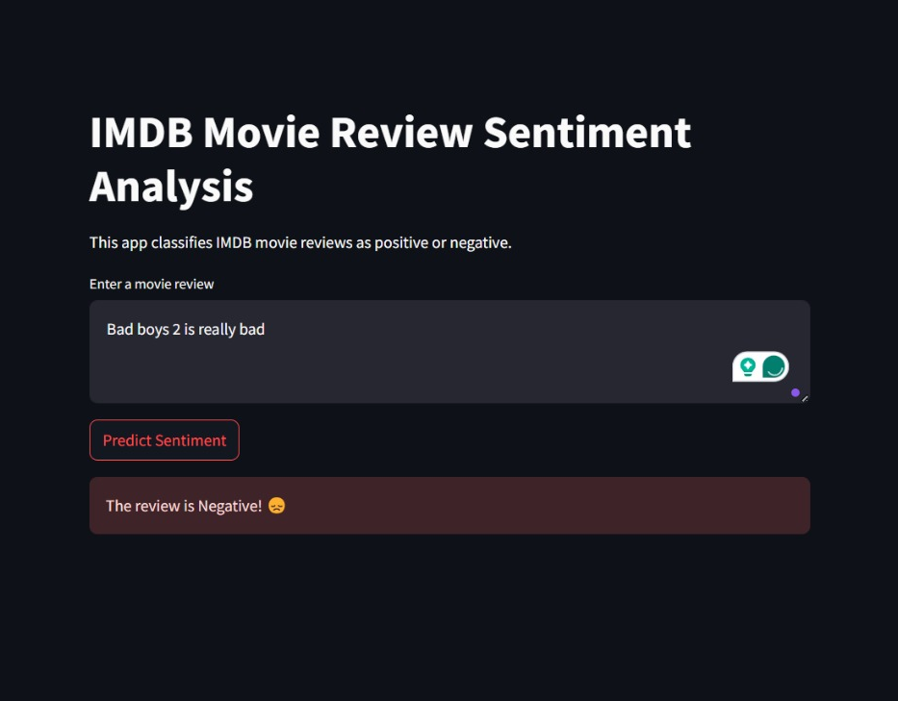
Streamlit Web App Deployment

Slide 14

Special Thanks,
Team Members
Adham Hany Ahmed
Omar Alaaeldin Mohamed
Omar Wael Abd-Elstaar
Michael Abdallah Mikhail Heshema
Omar Khaled Mahmoud Mohammed
Abdelrhman Moustafa Mohamed

